Slide 1

Enhancing Revenue and Customer Understanding for Health Care Insurance Company
Using BIG DATA ECOSYSTem Saalu DAHAL

Slide 2
Introduction
The purpose is to outline the functional and non-functional requirements for developing a Big Data analysis platform for a Health Care insurance company.
The product will provide a comprehensive data pipeline and analysis system to enhance the Health Care Insurance company’s ability to understand customer behavior and improve revenue through targeted offers and royalty calculations.

Slide 3
Problem statement
Challenges in implementing the data from various multiple sources.
Working on a comprehensive data pipeline and analysis system to enhance the Health Care insurance company's ability.

Slide 4
Tools and Technologies
AWS S3
AWS Redshift
DataBricks
Pyspark
Jira
GitHub

Slide 5
Data Ingestion
Uploaded sample data to AWS S3
Steps:
Organize the raw data file into appropriate folders.
Upload the data into s3.
Load the data using databricks notebook.

Slide 6
Data Cleaning
Removing incorrect and duplicate data.
Ensuring reliable outcomes and algorithms.
Cleaning Activities
Checking for null values.
Replacing null values with “NA”
Checking and removing duplicates

Slide 7
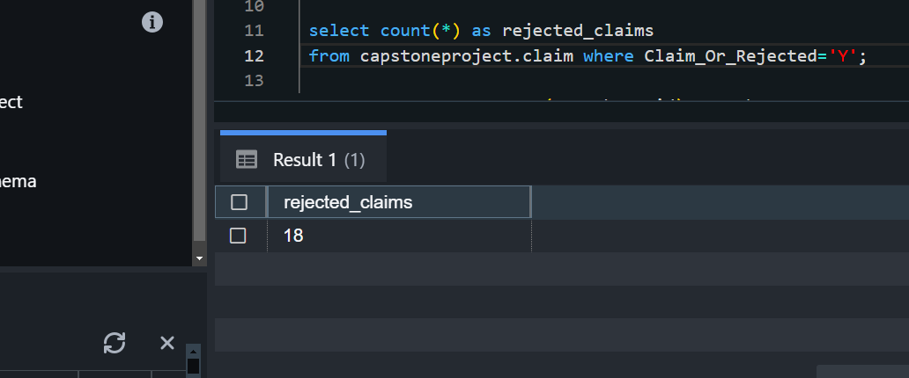
Use Cases and Requirements

Slide 8
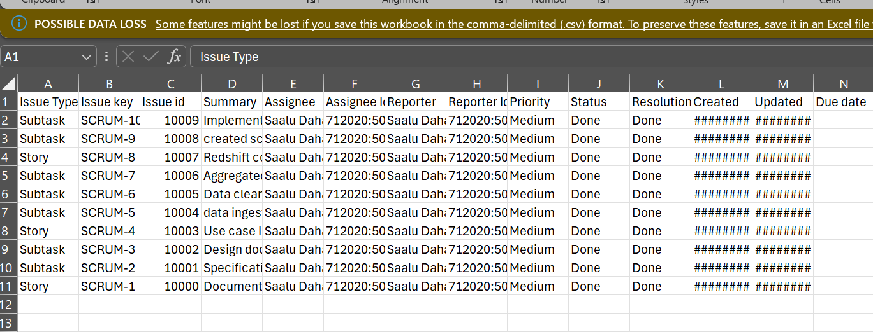
Jira Sprint Planning
Week 1 Planning
Create requirement specification document.
Develop solution design document.
Implementation

Slide 9
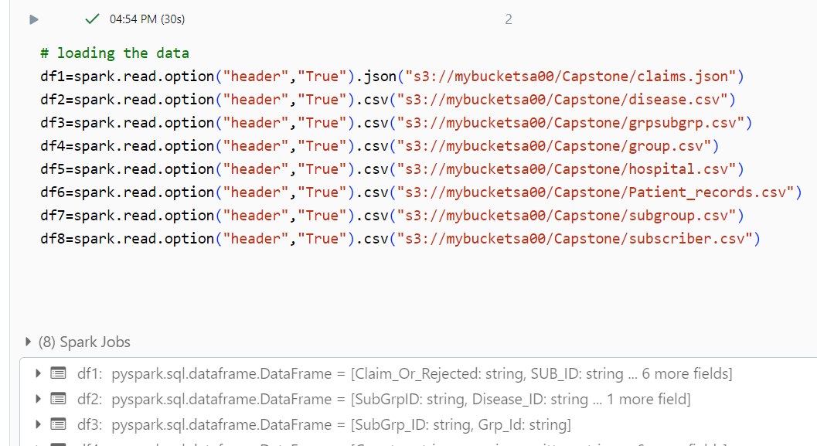
Visualizations

